Slide 1
Covid-19 Vaccination of Opinion Mining with Decision making using Protege Tool by Dr. Rakesh Kumar D
Project on Knowledge graphs

Slide 2
INTRODUCTION
Coronavirus disease 2019 (COVID-19) is a contagious disease caused by the virus SARS-COV-2. The first known case was identified in Wuhan , China, in December 2019. The disease quickly spread worldwide, resulting in the COVID-19 Pandemic
Ontologies are formal definitions of vocabularies that allow you to define complex structures as well as new relationships between your vocabulary terms and between members of the classes that you define.

Slide 3
Covid -19 Ontology on Student information
This Covid-19 ontology helps in analyzing the risk factors and treatment plans for the respective individuals i.e., students based on their given details which include diagnosis, symptoms, and vaccination history. After the classification , with the help of opinion mining the classified data is stored in the database
The data will be retrieved through SPARQL which helps to retrieve complex queries. This Covid-19 ontology helps in analyzing the risk factors and treatment plans for the respective individuals

Slide 4
Schema on covid-19 ontology
The main components of ontology are
Classes represent concepts that are taken in a broad sense
Attributes describe the classes in the ontology ex: A student has a name, Id, Branch, roll number, etc.,
Relationships make explicit the link between the classes in the same domain
In this ontology, the information given by the students can be automatically processed and with the help of SWRL and SPARQL queries, the risk factor and treatment plans for the students are inferred from the given OWL knowledge.

Slide 5
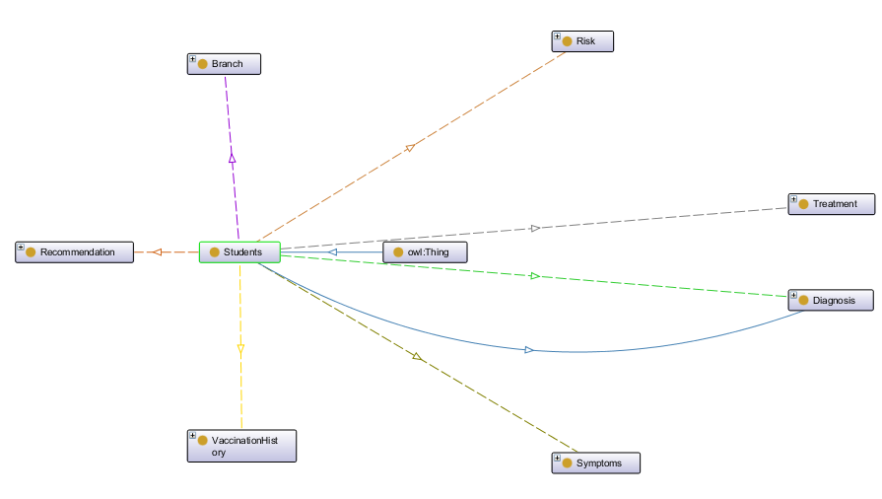
Schema on covid-19 ontology

Slide 6
CLASSES
Adding Classes:
Step 1: Open the "Classes" tab
Window → Tabs → Classes
Step 2: The empty class tree contains one class called owl: Thing, which is the superclass of everything.
Step 3: Create subclass Students. This is the subclass of owl: Thing.
Step 4: To add a subclass select owl: Thing and click on the icon shown in Figure 2 then the window will appear to enter the subclass name

Slide 7
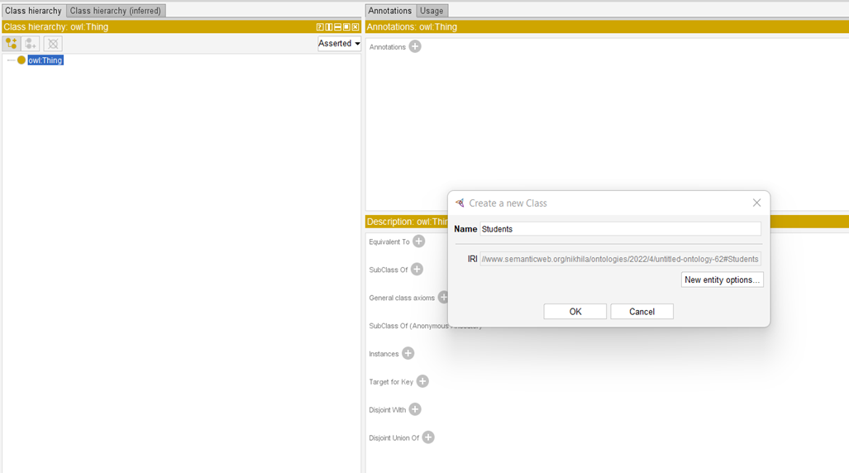
Classes
Adding subclass

Slide 8
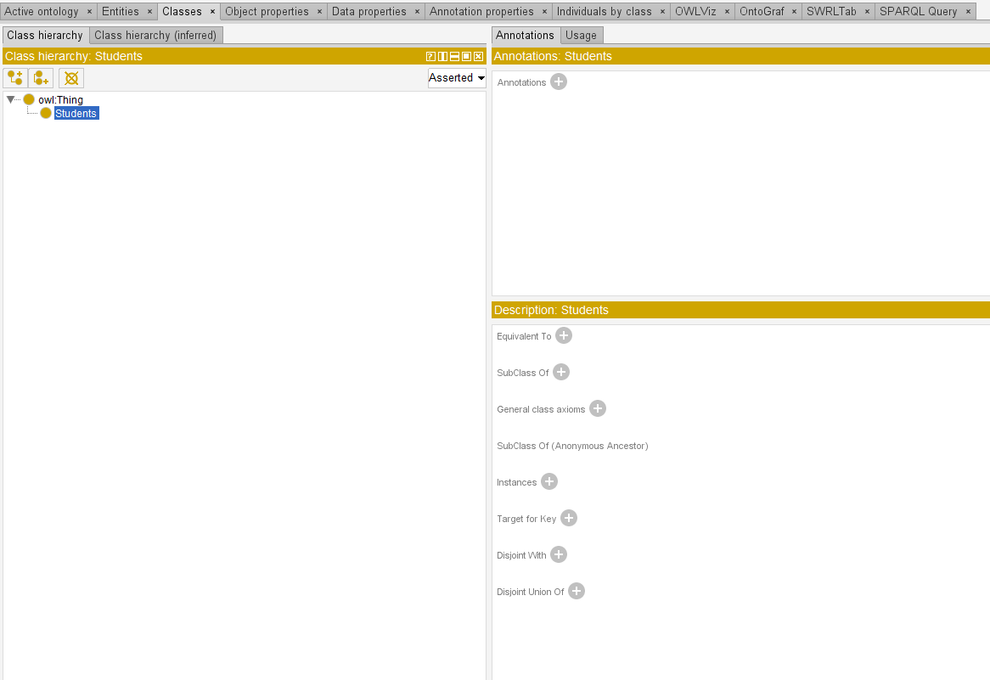
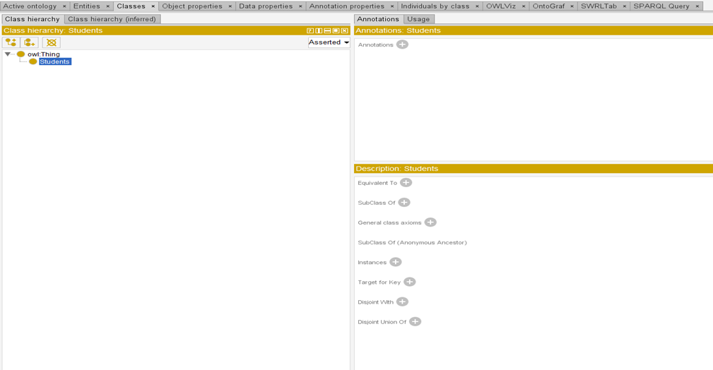
Adding Sibling to the class and Deleting class
Adding sibling to the class
deleting selected classes

Slide 9
Creating of Class hierarchy
Creating class hierarchies helps to speed up the process of adding classes.
Steps to create a class hierarchy:
Step 1: Select owl: Thing.
Step 2: Click on Tools and select create class hierarchy
Step 3: Now, select the root class owl: Thing -> Continue Then the Enter hierarchy window will appear where the class ontology should be given
Step 4: After entering the class hierarchy click on continue, then if we want to make the subclasses disjoint, we need to check the box
Step 5: Click on Finish and the Class hierarchy for Covid-19 ontology is created

Slide 10
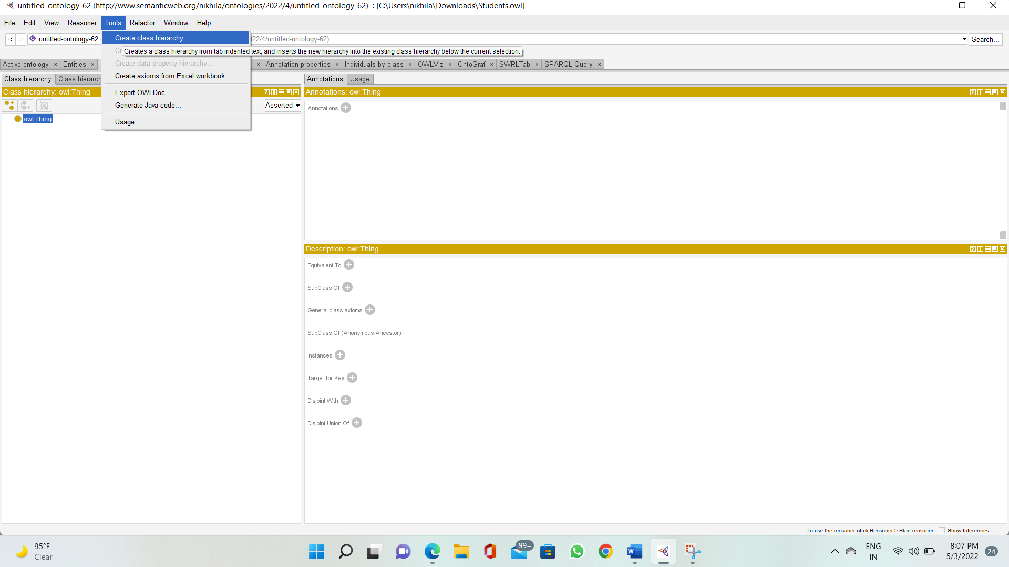
Creating the class hierarchy

Slide 11
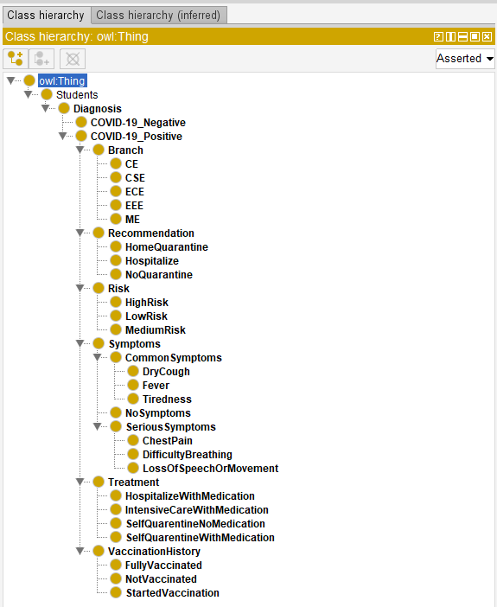
Class hierarchy for Covid-19 Ontology

Slide 12
OWL Properties
OWL PROPERTIES:
Relationships between two objects are represented by OWL Properties
There are two main characteristics:
a. Object properties: connect objects
b. datatype properties: connect an object to an XML Schema datatype or an rdf: literal
Annotation properties are another OWL property that can be used to add annotation information to classes, individuals, and properties.
Object Properties (Domain and Range):
i. Make sure the "Object Properties" tab is open.
ii. Window → Tabs → Object Properties.
Data Properties:
i. Ensure that the "Data Properties" tab is open.
ii. Window → Tabs → Data Properties.
3.2.1 Object Properties:
In OWL all properties are a sub-property of topObjectProperty.

Slide 13
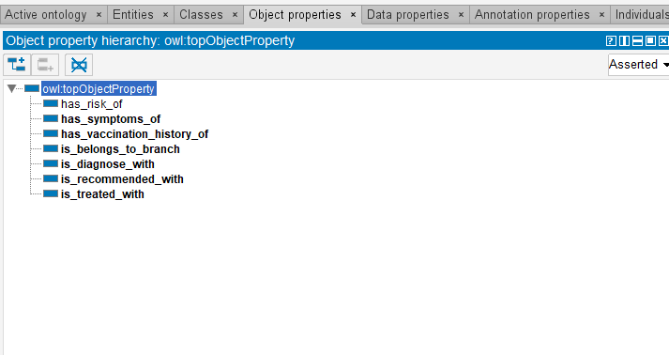
Adding sub-properties
Fig. :Object Property Hierarchy

Slide 14
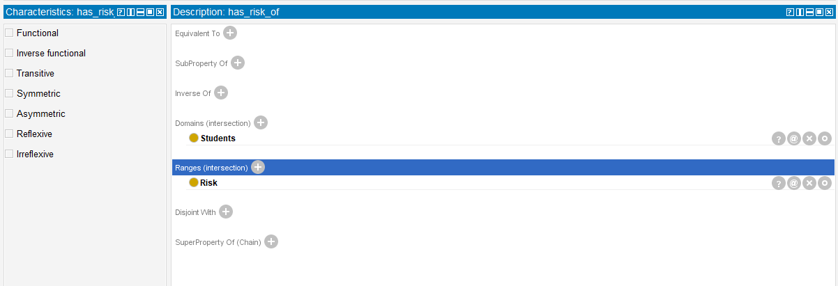
Adding Domains and ranges
Fig.: Domains and ranges for the object property has_risk_of

Slide 15
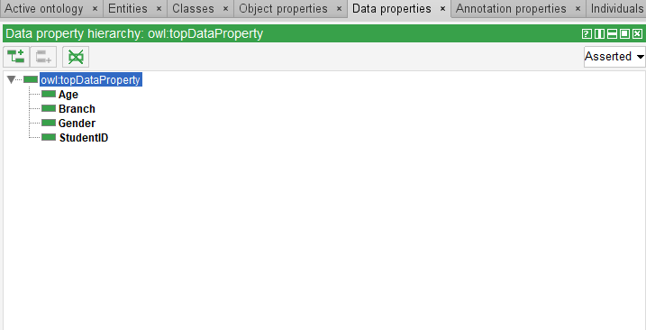
Data Properties
Fig:Data Properties superclass owl:topDataProperty

Slide 16
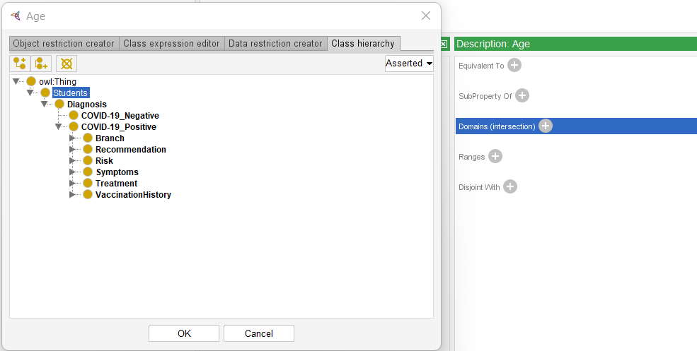
Adding Domains and Ranges to the selected property add a domain, select the property and click on the domain(intersection)+ button and select the domain, then click on “OK” as shown in the figure below.
Fig: Adding Domain to the selected property.

Slide 17
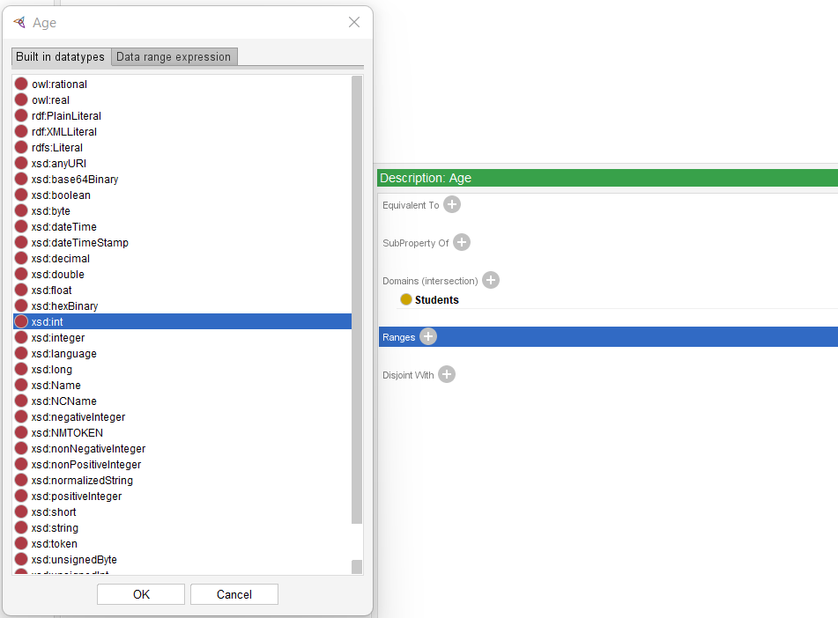
Adding Domains and Ranges to the selected property

Slide 18
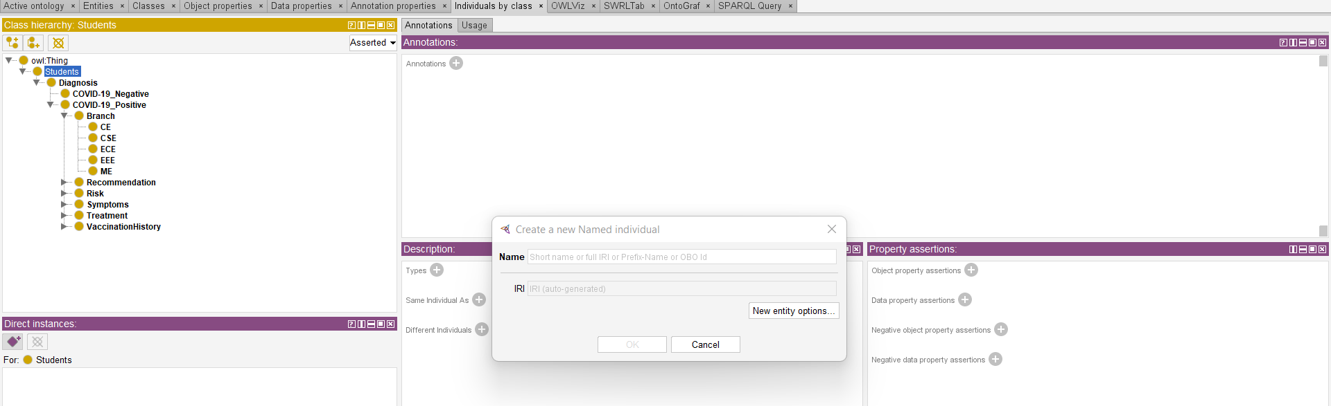
Adding Individuals Individuals (instances) are the fundamental, "bottom-up" components of an ontology. Certain data properties are intentionally omitted for the sake of brevity. The final step in developing the ontology is to include individuals. To do so, go to the "individuals" tab and select the "Add individual" icon.
Add Individual button

Slide 19
Ontology Visualizing Tools
VOWL visualize the ontology graphically, we must first install the ProtégéVOWL plugin
OWLViz is intended for use with the Protege-OWL editor.
OntoGraf allows you to navigate the relationships in your OWL ontologies interactively.

Slide 20
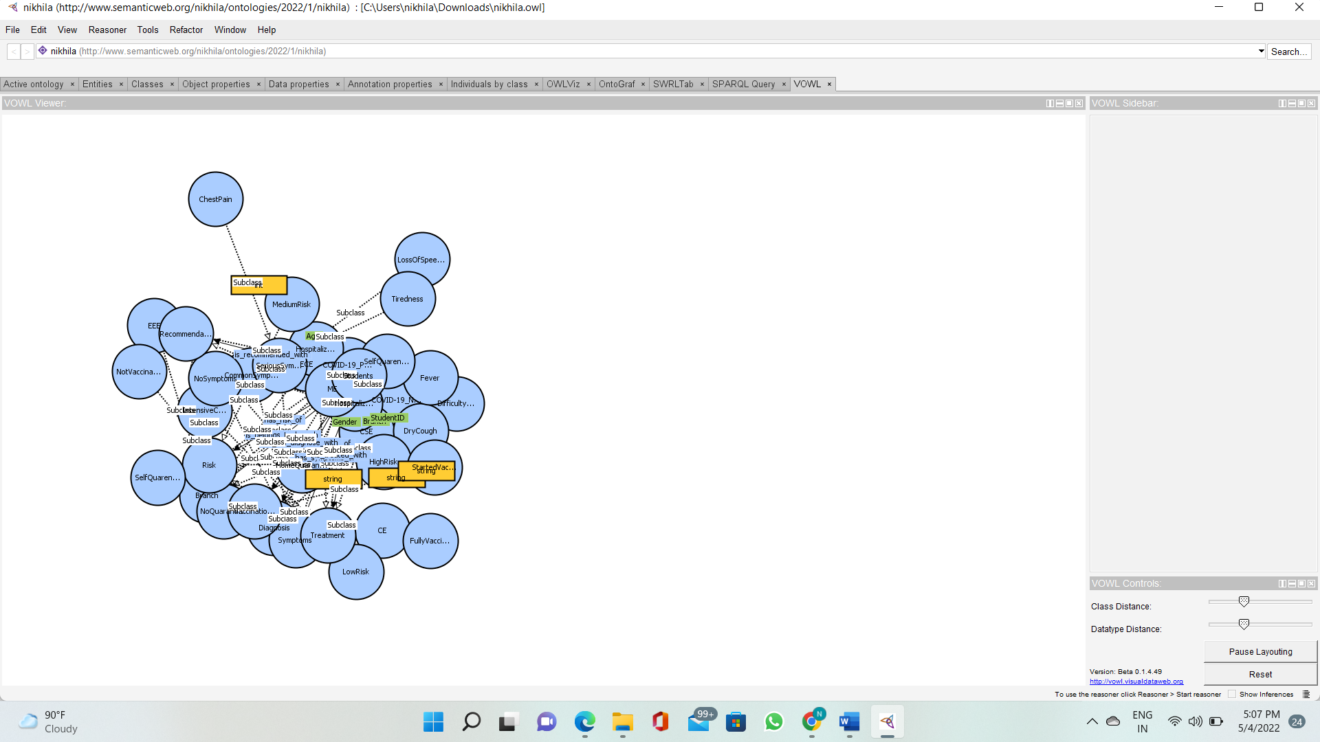
VOWL Representation of Covid-19 Ontology VISUALIZATION OF ONTOLOGY WEB LANGUAGE

Slide 21
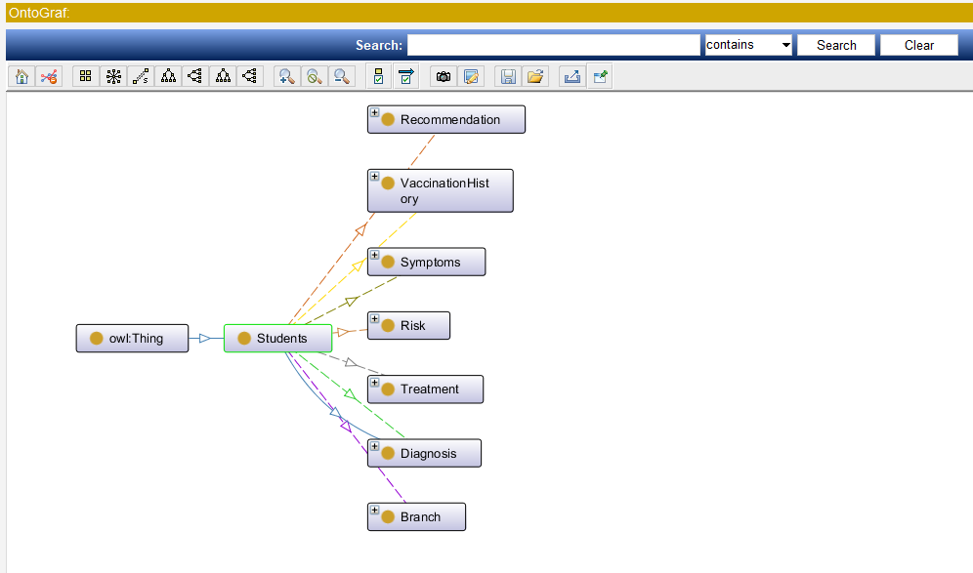
OntoGraf Representation of Covid-19 Ontology

Slide 22
Rules
The SWRL Tab is a Protégé plugin that allows working with SWRL rules and SQWRL queries in a development environment.
Using the Drools rule engine.
Press the 'OWL+SWRL-> Drools' button to transfer SWRL rules and relevant OWL knowledge to the rule engine.
Press the 'Run Drools' button to run the rule engine.
Press the 'Drools->OWL' button to transfer the inferred rule engine knowledge to OWL knowledge.
The SWRLAPI supports an OWL profile called OWL 2 RL and uses an OWL 2 RL-based reasoner to perform reasoning.
See the 'OWL 2 RL' sub-tab for more information on this reasoner

Slide 23
SWRL rules
Fig : Rules for analyzing risk factors and treatment plan of Covid-19 students.

Slide 24
Queries
SPARQL Protocol and RDF Query Language is an RDF query language—that is, a semantic query language for databases—able to retrieve and manipulate data stored in Resource Description Framework (RDF) format. SPARQL query to know the count of the covid-19 positive and covid-19 negative number of students

Slide 25
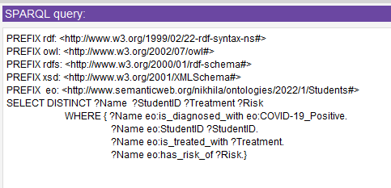
Querying COVID-19 Ontology using SPARQL Queries.
Fig.: Analyzing risk factors and treatment plans

Slide 26
output
The result obtained using Covid-19 ontology is shown in the figure below. The ontology model is queried using SPARQL with the input of diagnosis of students and details of covid-19 diagnosed student details are extracted and their treatment plan and risk factors were given based on student’s vaccination history, symptoms, and diagnosis.

Slide 27
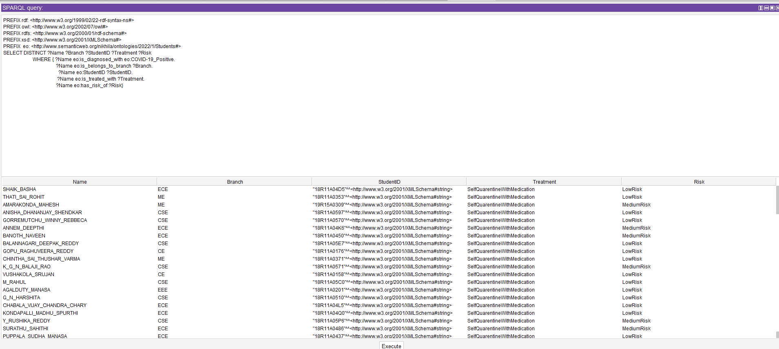
Output
Fig.: Result of total students count based on diagnosis

Slide 28
Conclusion and Future Works
The goal of our research is to gather student data to assist medical practitioners and other researchers in carrying out analyses, forecasting, as well as classifications.
I have worked on project not only this application but on Indian Railways tweets ontology.
In the future, we will intend to create a semantic annotation interface to that student data from Covid-19 can be automatically annotated using the COVID-19 ontology and make more efficiently intelligence by applying knowledge graphs with machine learning and deep learning techniques

